Slide 1

Building A Serverless Music App

Slide 2
SERVICES USED FOR THE PROJECT
Aws S3
Aws Cloud Front

Slide 3
Step 1
Go to Aws S3
Create a Bucket with name “simple-music-app”

Slide 4
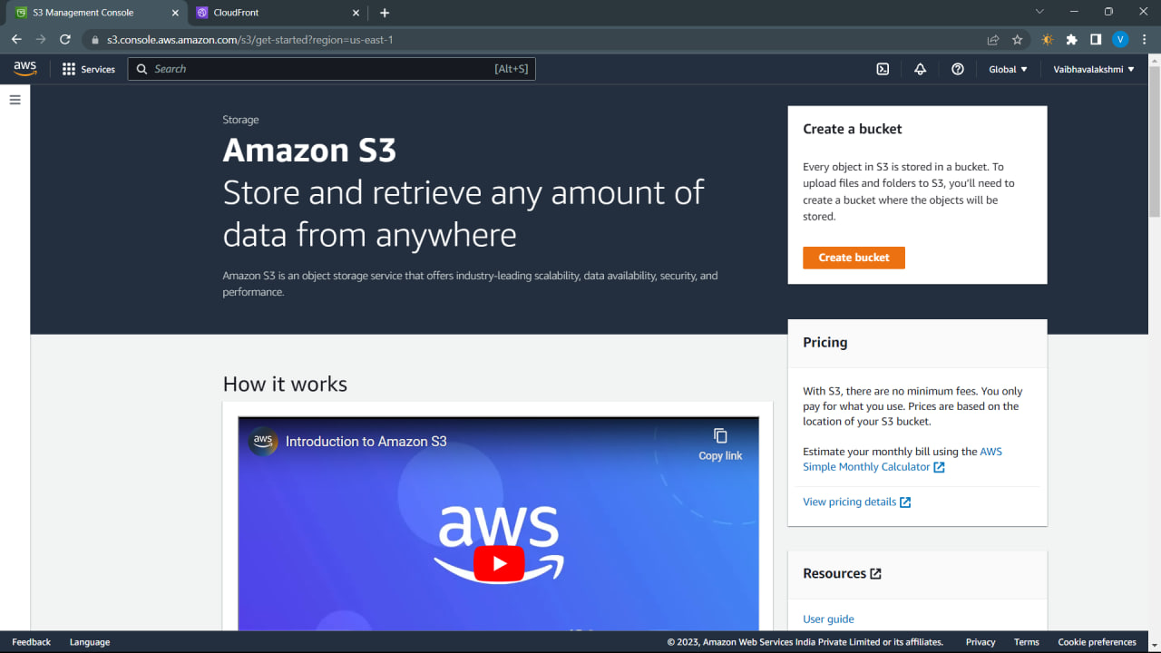

Slide 5
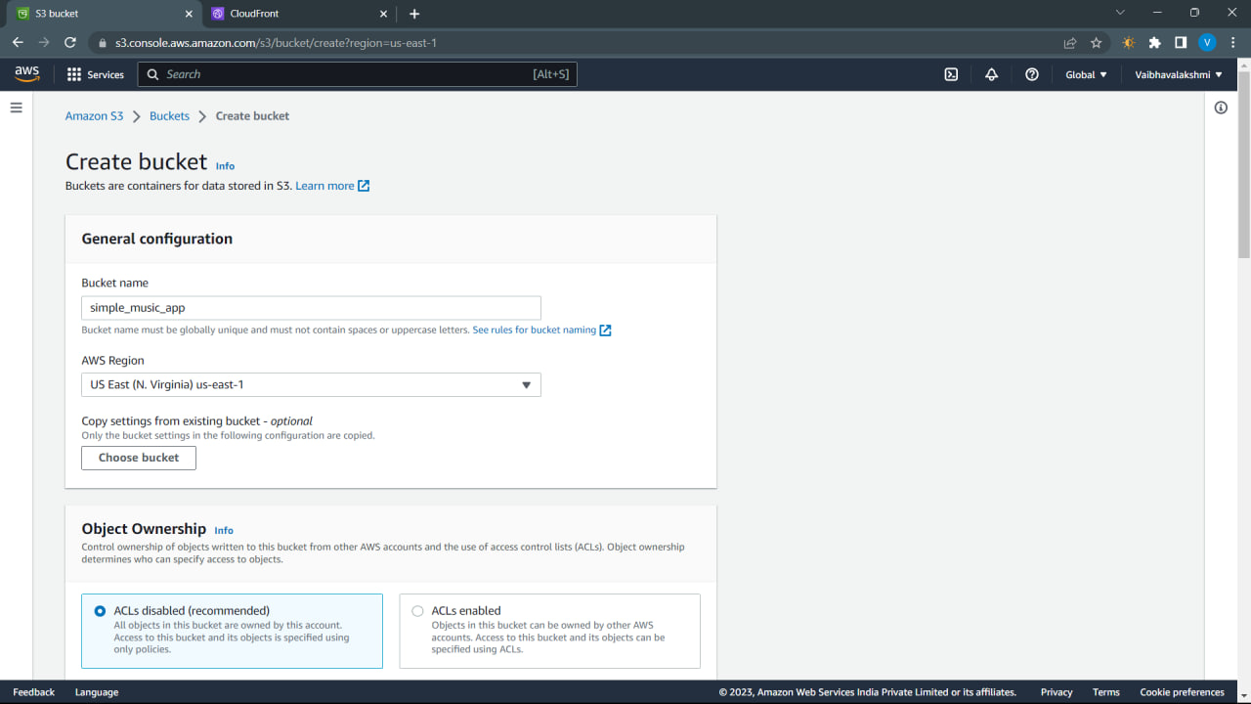

Slide 6
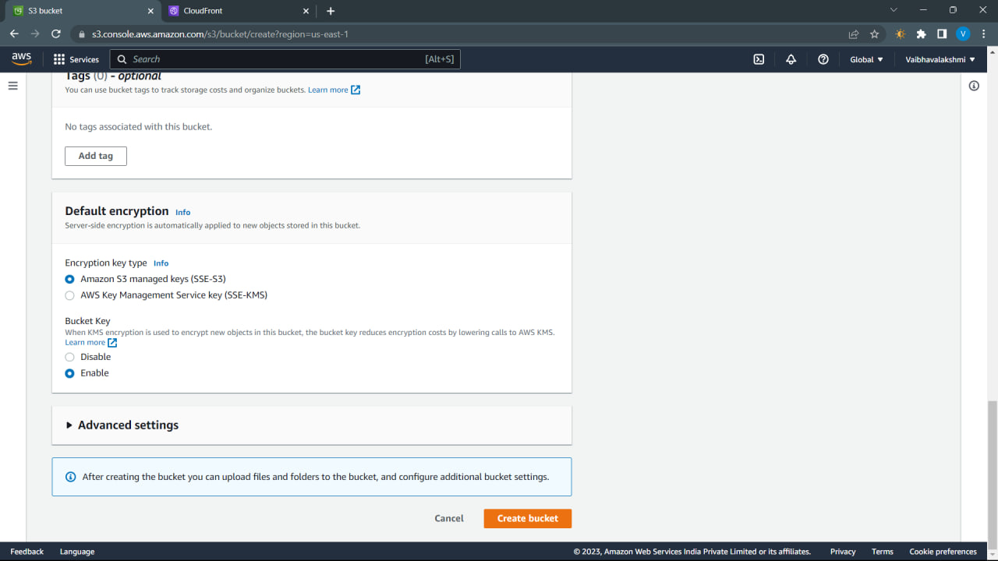

Slide 7
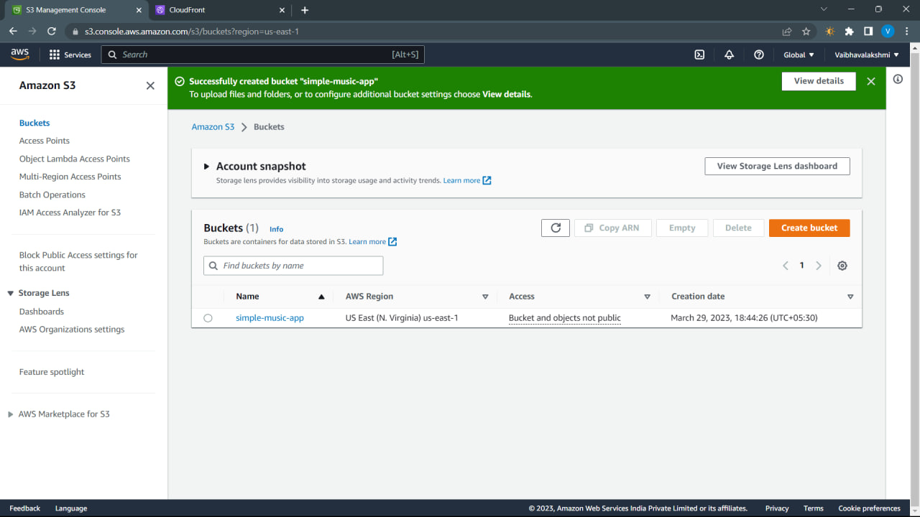

Slide 8
Step 2
Go to Aws Cloud front
Create a new Distribution

Slide 9
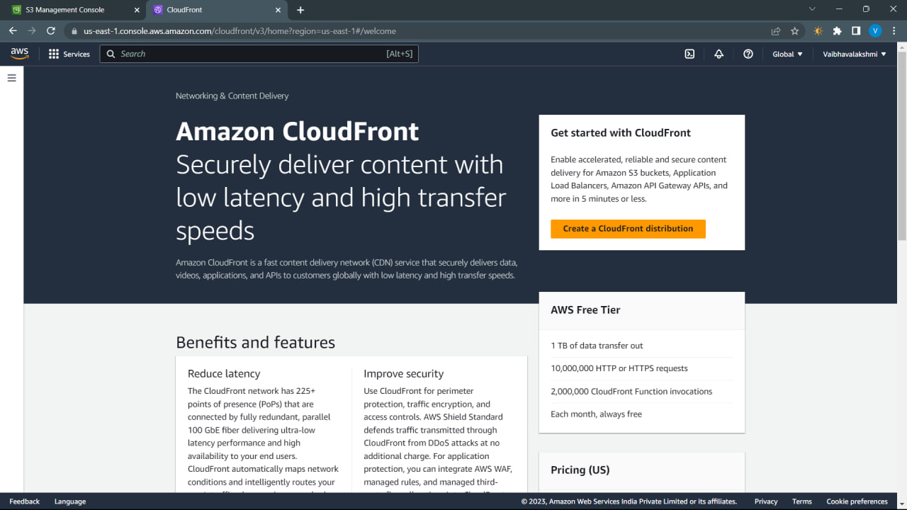

Slide 10
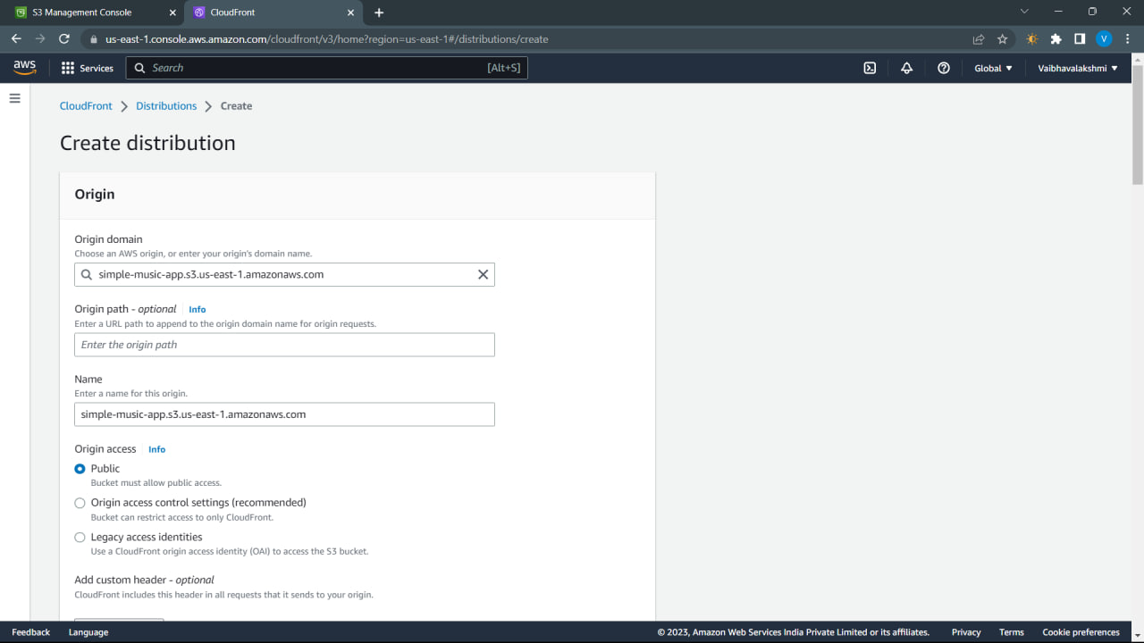

Slide 11
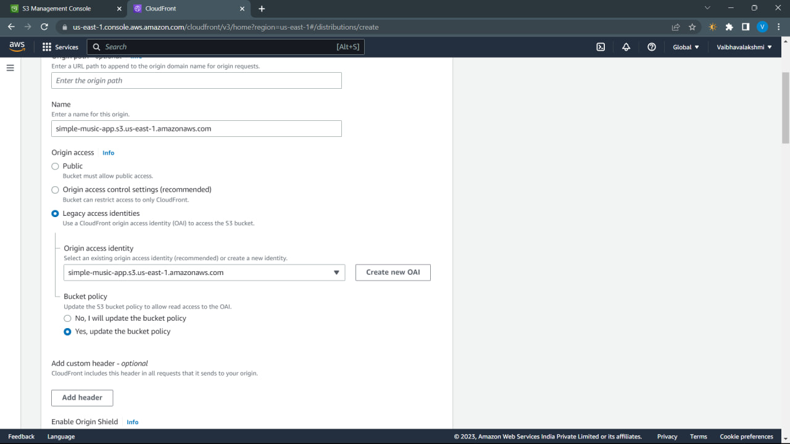

Slide 12
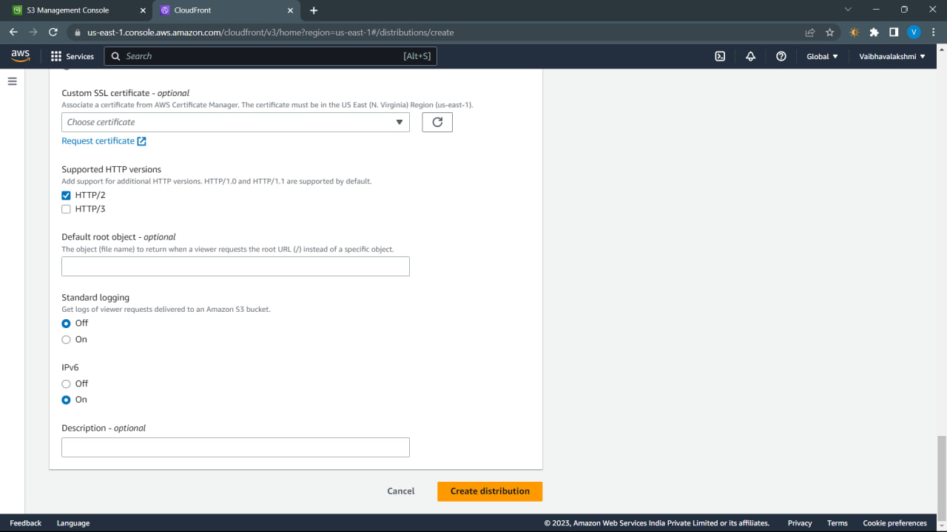

Slide 13
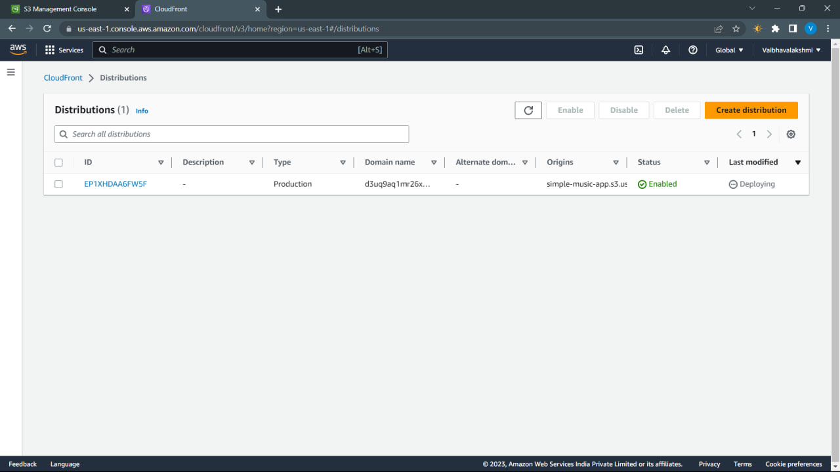

Slide 14
Step 3
First download some music files
Import those music files into S3 bucket

Slide 15
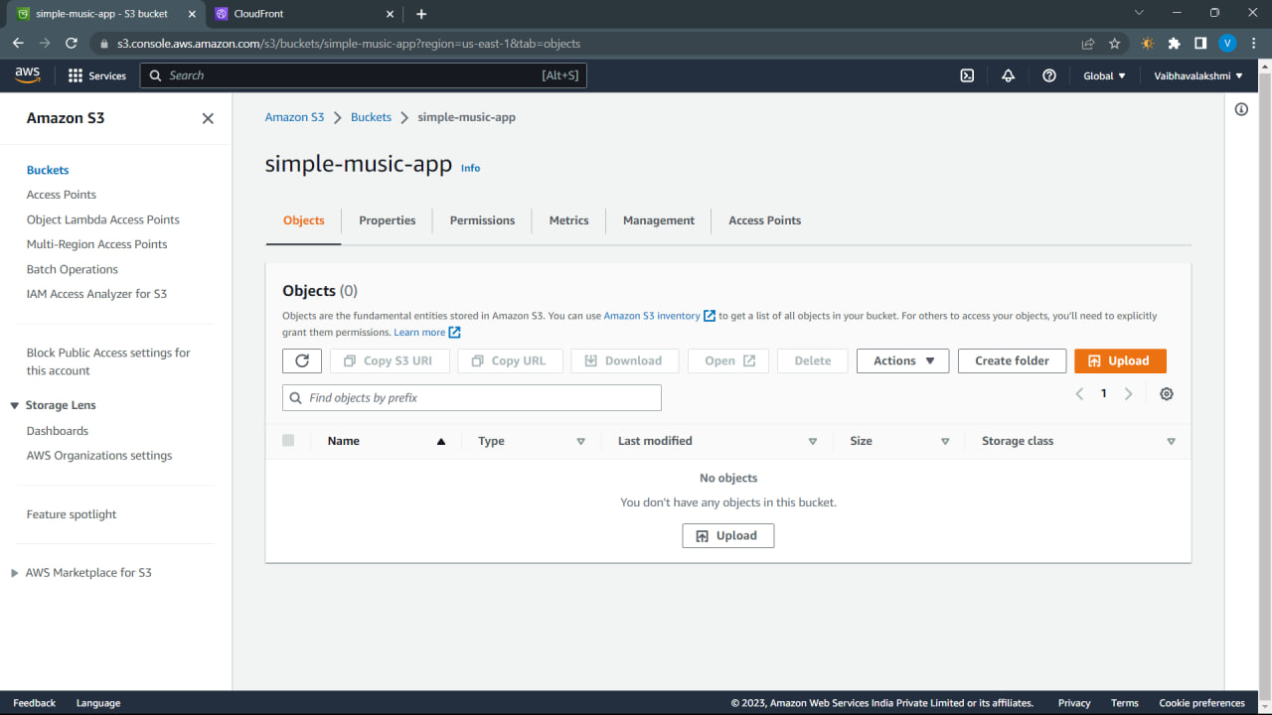

Slide 16
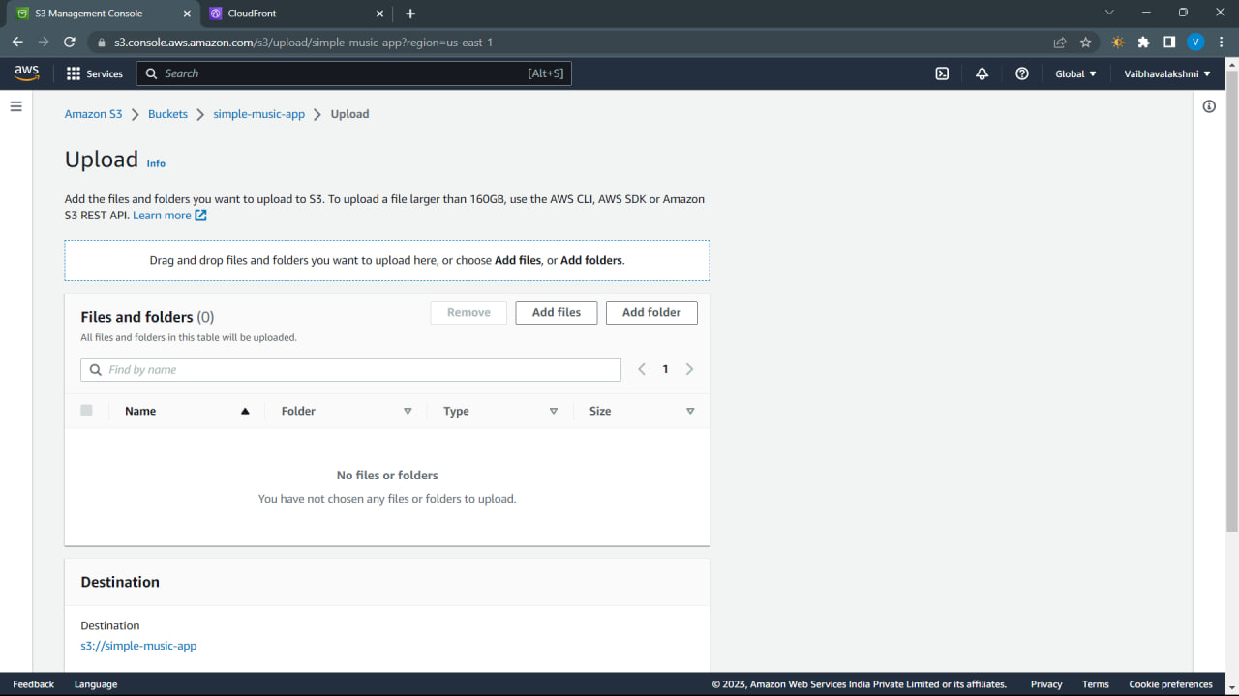

Slide 17
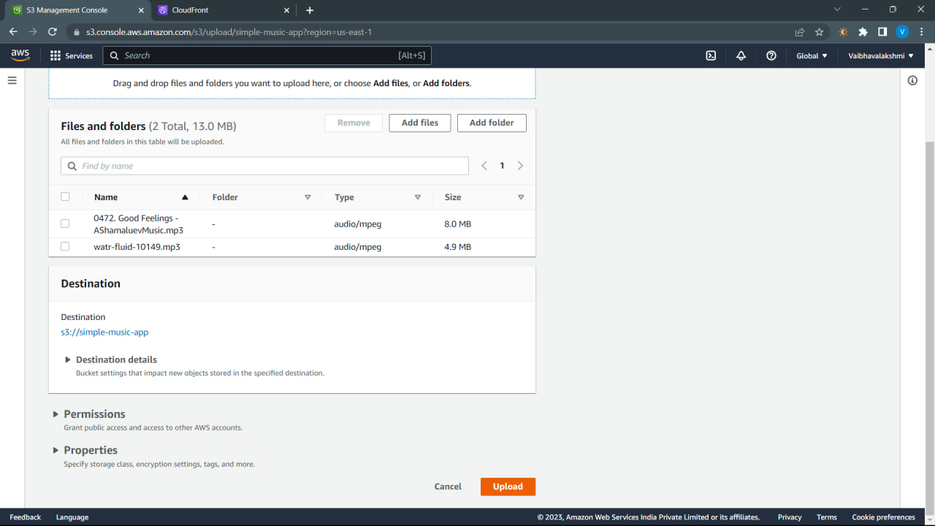

Slide 18
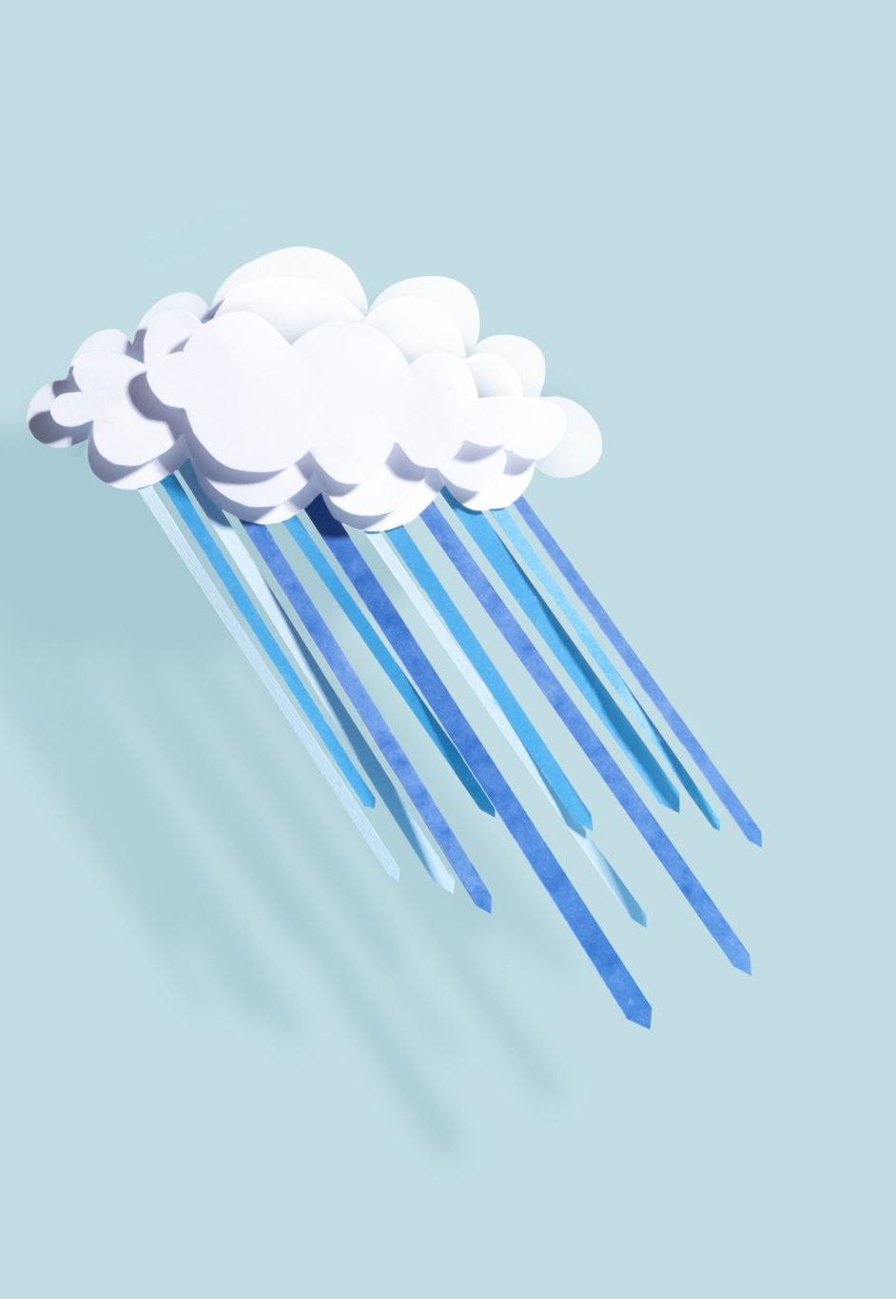
Step 4
Check whether the music is playing or not using cloud front Distribution domain name

Slide 19
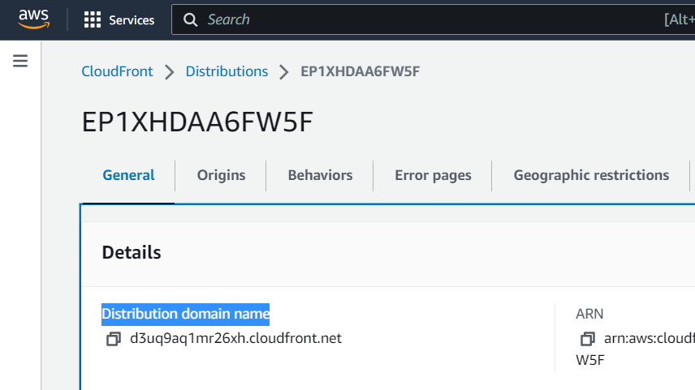

Slide 20
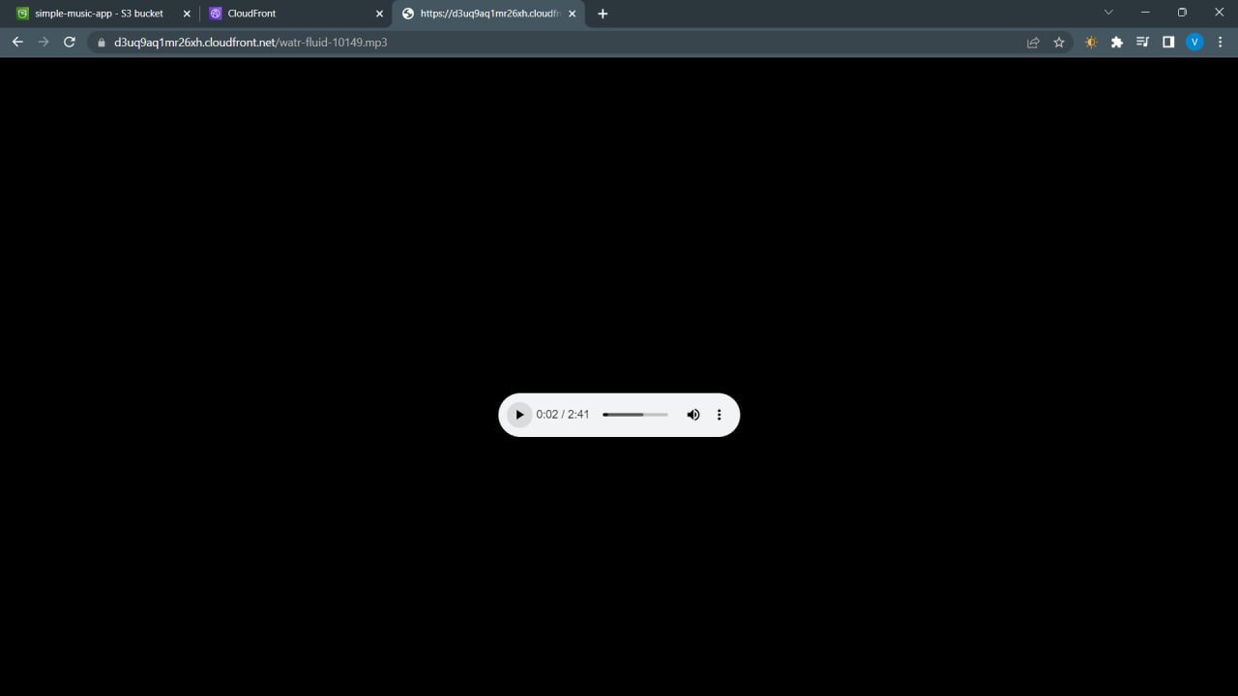

Slide 21
Step 5
Create a new file name index.html
And write code and upload it into AWS s3

Slide 22
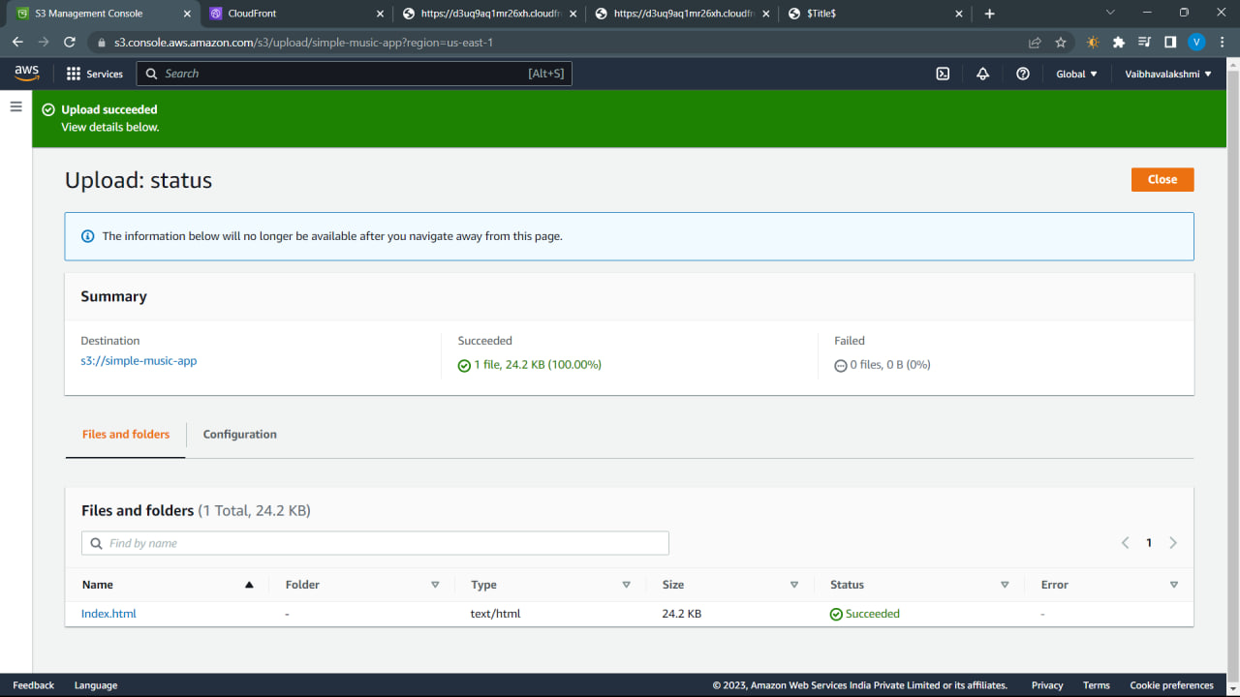

Slide 23
Final output

Slide 24
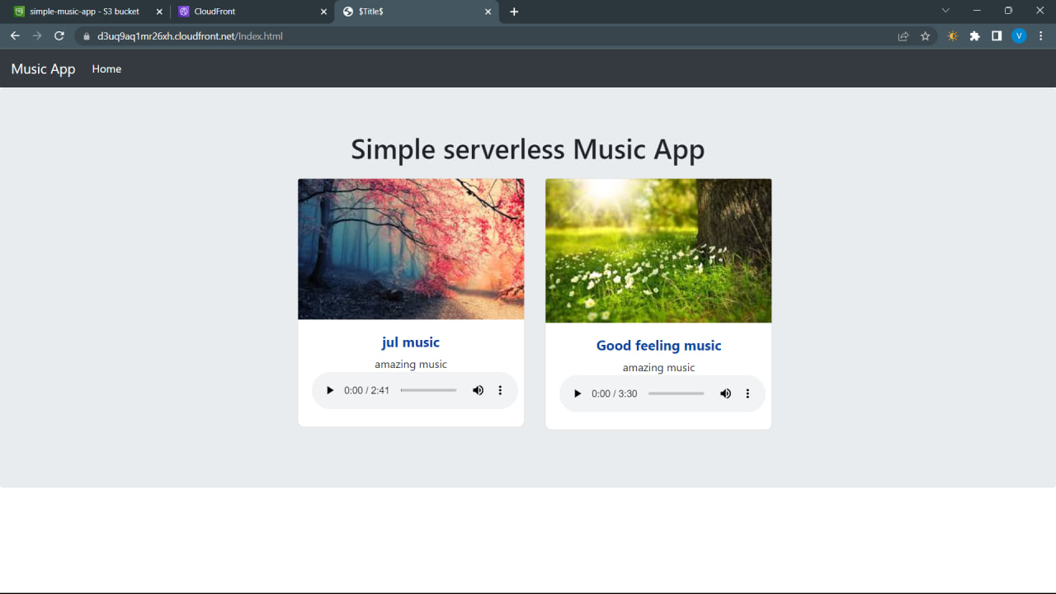

Slide 25
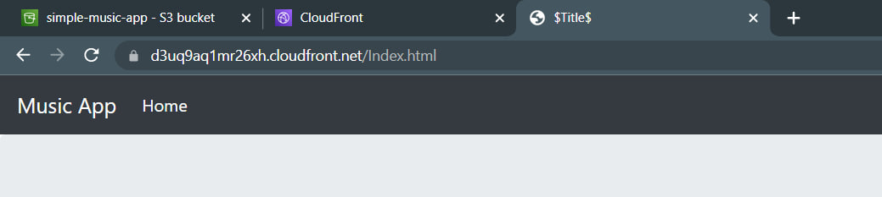
https://d3uq9aq1mr26xh.cloudfront.net/Index.html
https://d3uq9aq1mr26xh.cloudfront.net → this part is from cloud front
Index.html → this part is from AWS S3

Slide 26
Thank you

